Slide 1
Auto-cofig=“true”
到底说了什么？

Slide 2
有这么一种说法
auto-config="true"相当于配置了基本的一些组件：form-login、anonymous、http-basic、logout、remember-me

Slide 3
还有这么一种说法
spring security 3 设置auto-config =true时，会配置十个默认过滤器
SecurityContextPersistenceFilter
LogoutFilter
UsernamePasswordAuthenticationFilter
BasicAuthenticationFilter
RequestCacheAwareFilter
SecurityContextHolderAwareRequestFilter
AnonymousAuthenticationFilter
SessionManagementFilter
ExceptionTranslationFilter
FilterSecurityInterceptor

Slide 4
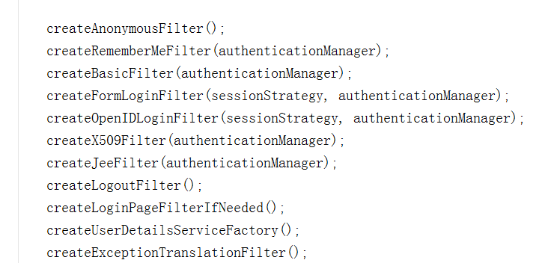
AuthenticationConfigBuilder

Slide 5
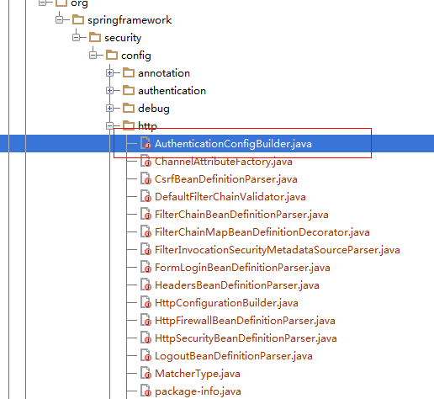

Slide 6
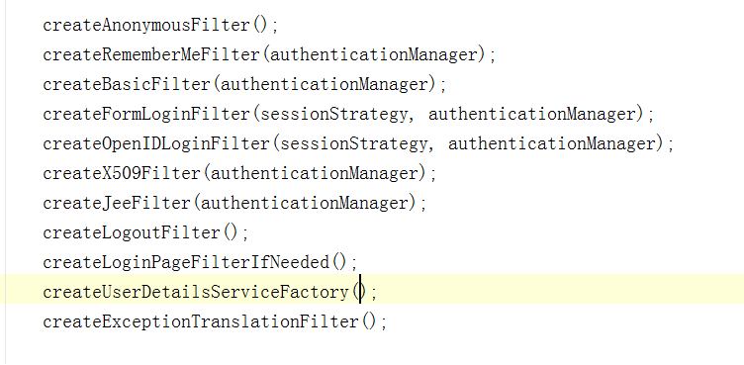
初始化函数

Slide 7
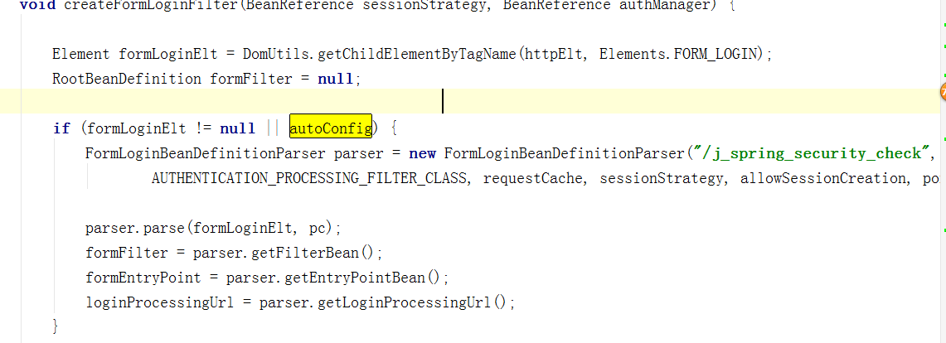
createFormLoginFilter

Slide 8
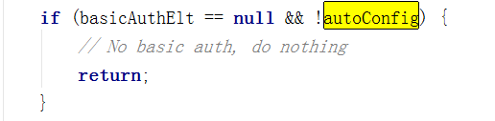
createBasicFilter

Slide 9
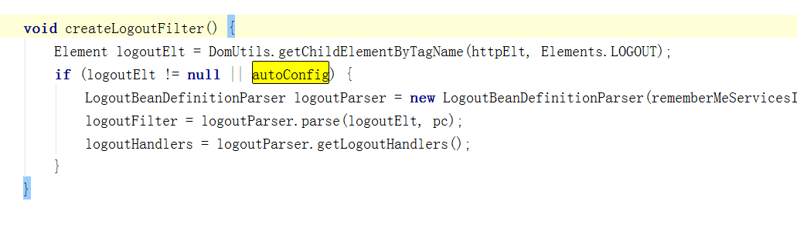
createLogoutFilter

Slide 10
其他

